Slide 1
Capstone Project – Stuttgart Appartments
By Axel Spahr

Slide 2
Problem Definition
Rents in Stuttgart were rising a lot over the last years. It is therefore often difficult to find an appartment that fits your needs whithin your given budget limit.
So with this Project we can help people to see, in which districts of Stuttgart they should start looking:
- If the rent demanded by the owner is too high for the spesific District
- Which district is the cheapest district
- Which area is the best regarding the venues
This project helps people who want to move to Stuttgart or people who already live in Stuttgart but are looking for a new apartment.

Slide 3
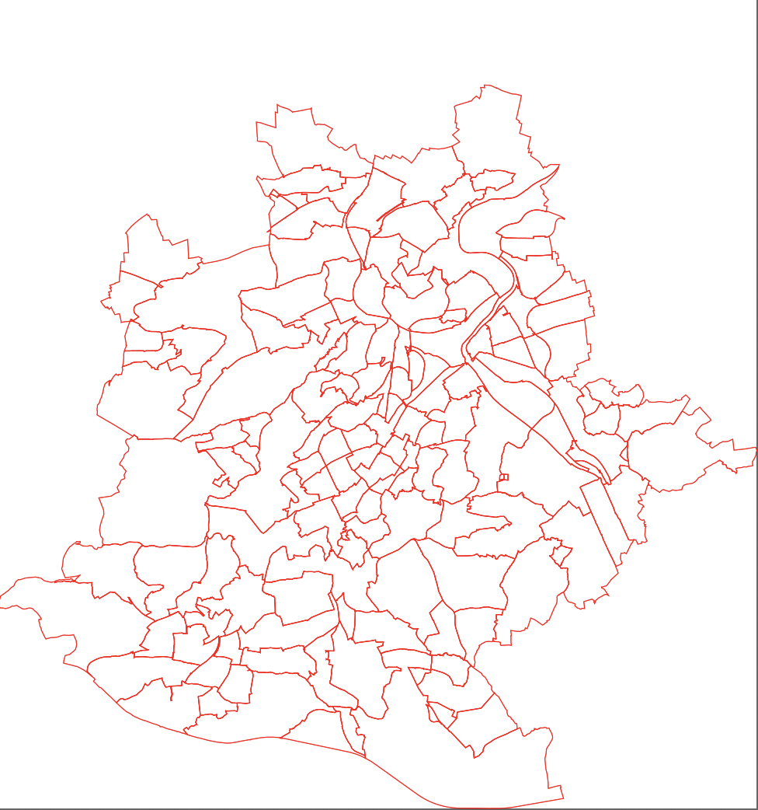
Data
The data on apartments (size, number of rooms, address, and price) is collected by scraping a local website with apartment listings (Immoscout24.de). For the coordinates of the districts we use geopy and take the Data from the official website of the city stuttgart (https://www.stuttgart.de/medien/ibs/KLGL_DXF.zipTo) that I labeld and converted my self. To Collect the Venues I use Foursquare. After the Data collection process we run k-means clustering to cluster the districts into residential and commercial areas and visualize the data on a choropleth map.

Slide 4
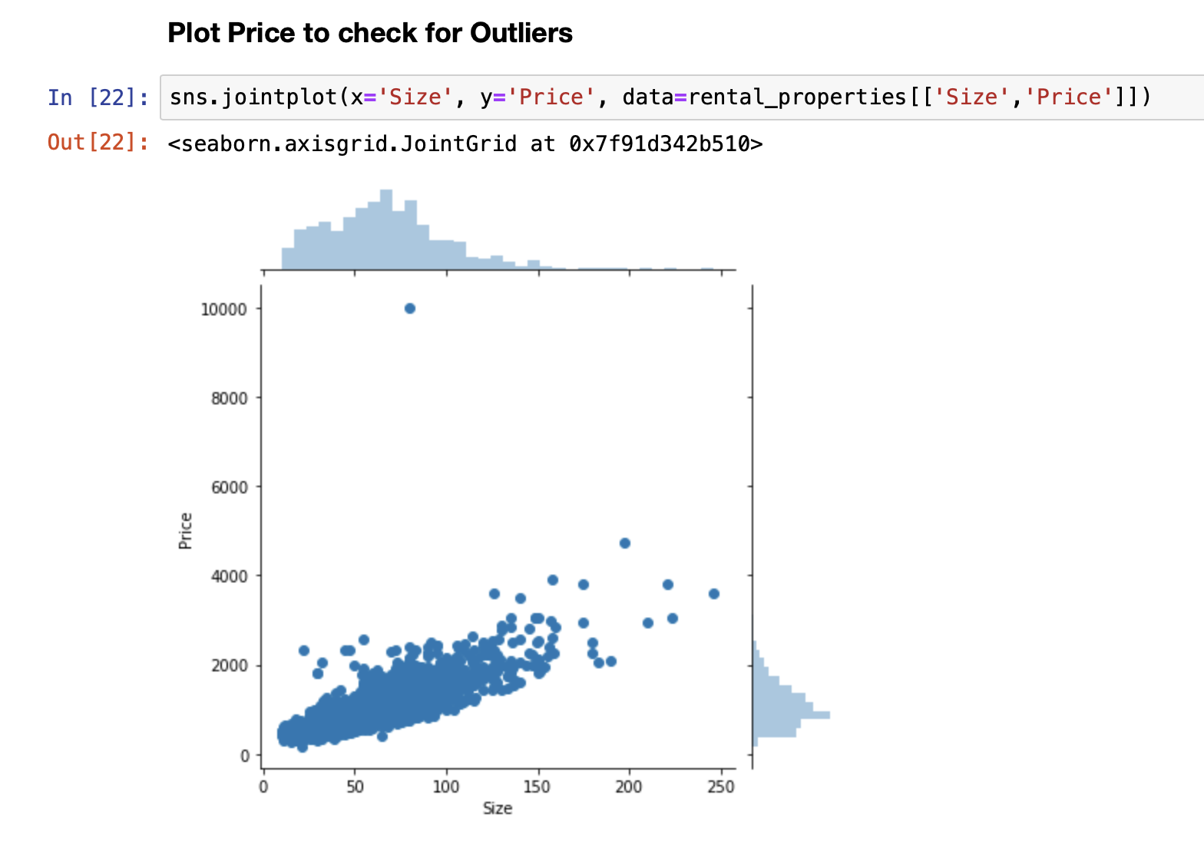
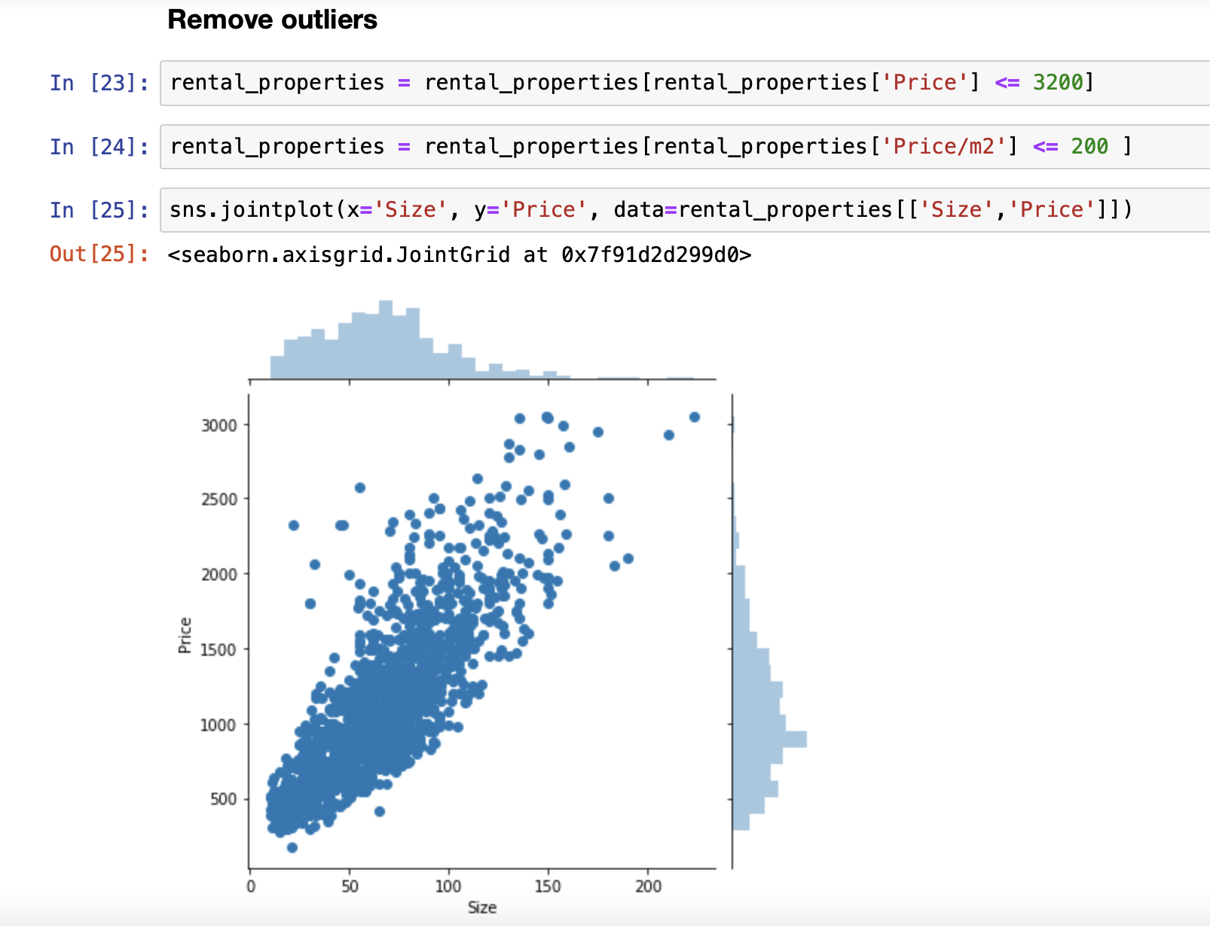
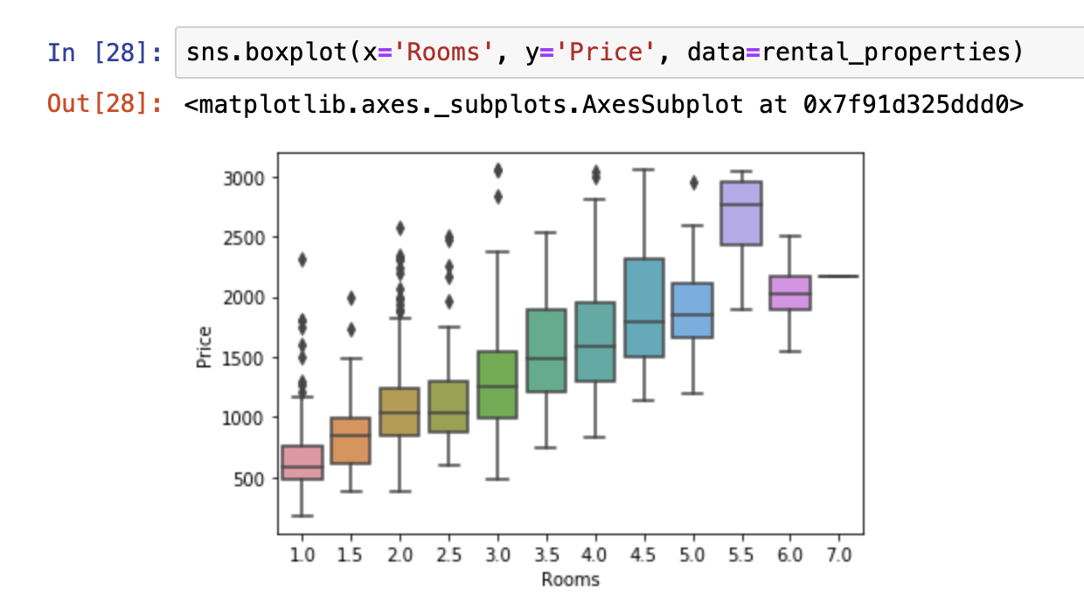
Methodology
Identification of outliners
Removing those outliners
Plotting dependencies

Slide 5
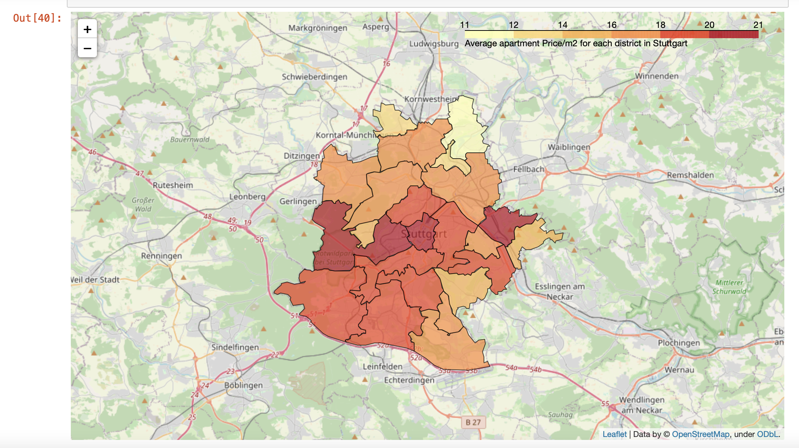
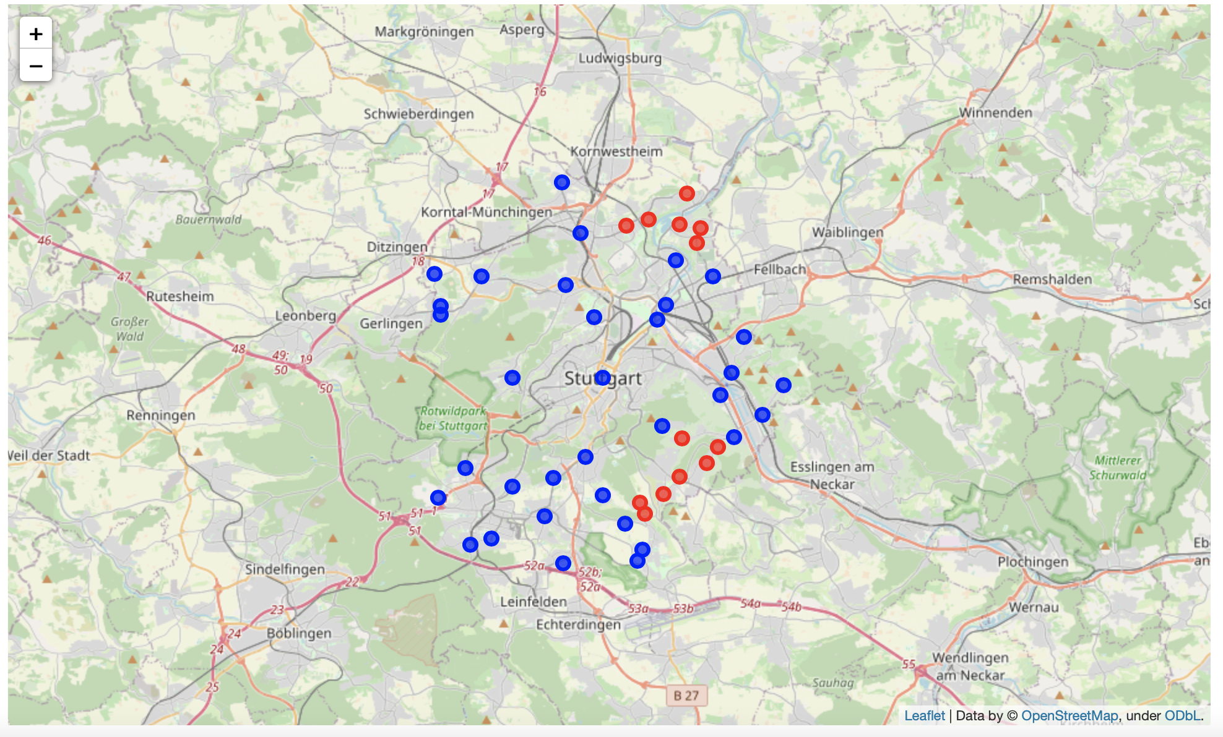
Methodology
Average appartment Price/m2 for each district in Stuttgart
Clustering the city districts

Slide 6
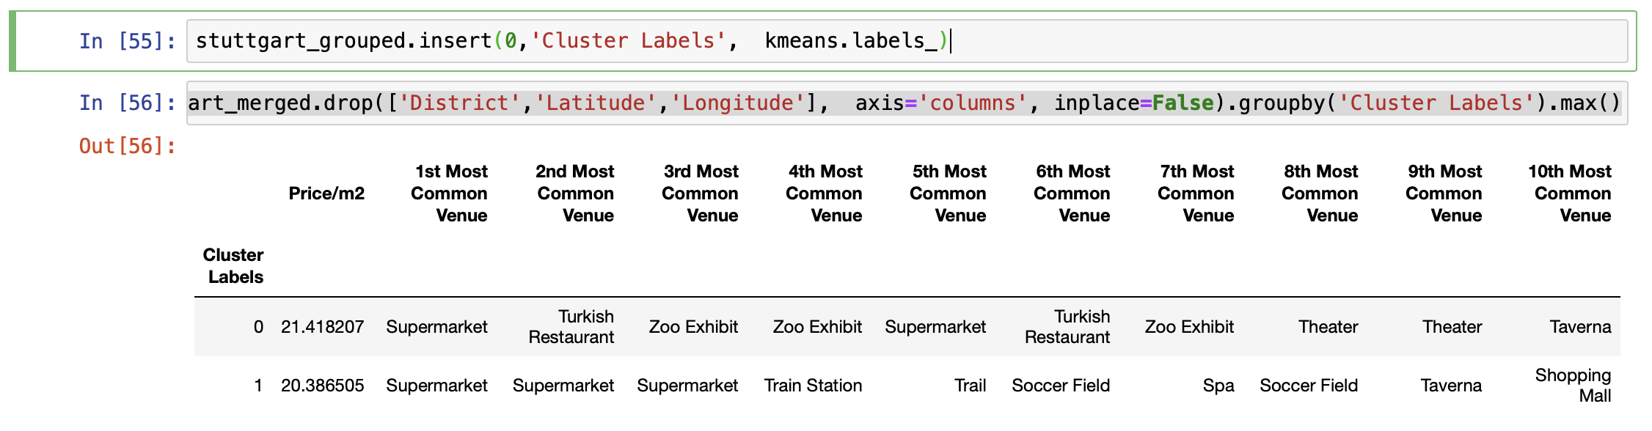
Results
By analyzing the clusters we can see that the blue cluster is more central and more commercial/touristic with restaurants, theaters, zoos, etc. while the red cluster is more decentral and residental with metro stations, supermarkets, and soccer fields.

Slide 7
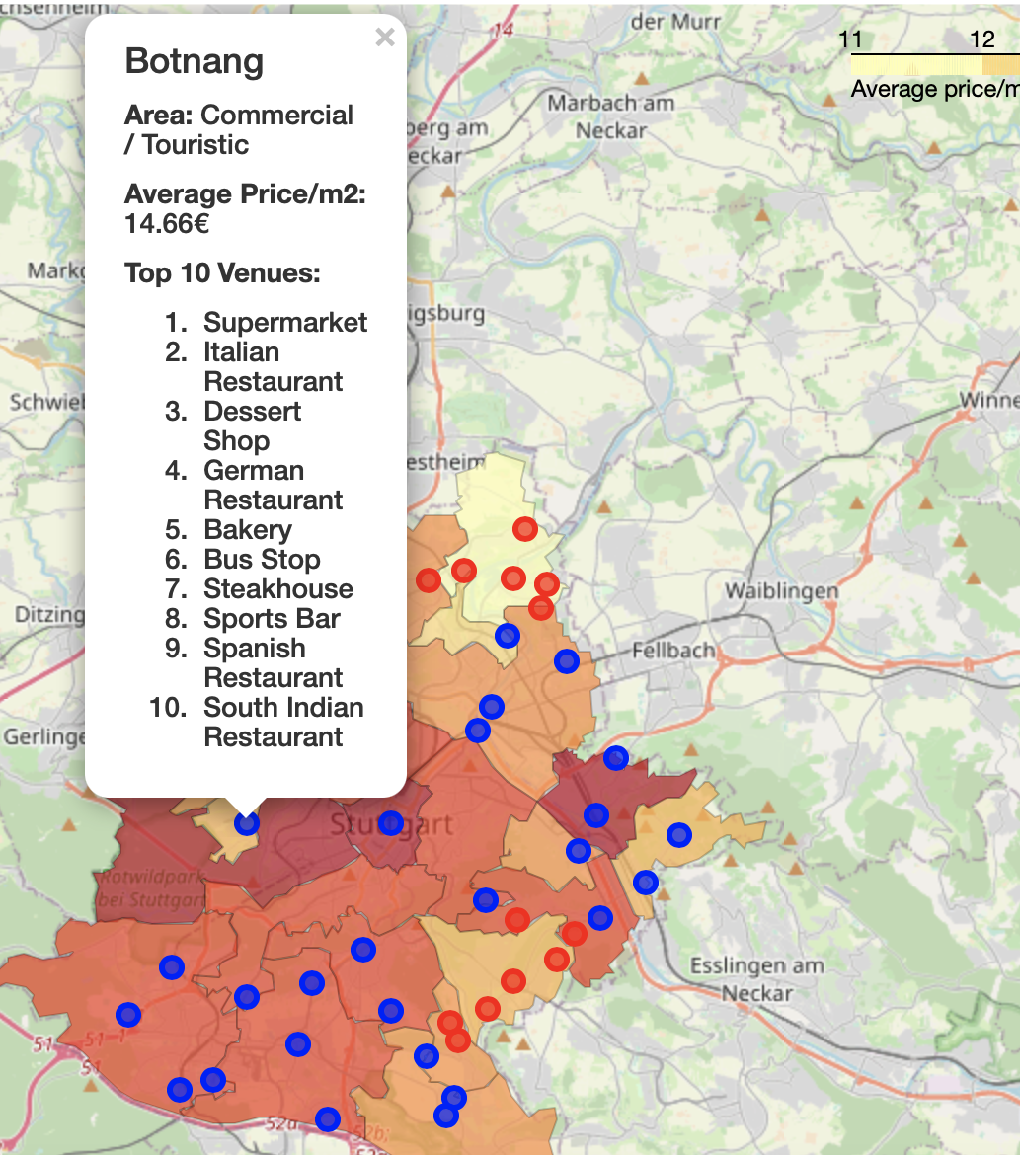
Conclusion
Based on our analysis we can determine that the districts West, Mitte and Untertürkheim are the most expensive district to live in, however by clustering we determined that there are several more similar districts where the price/m2 is significantly lower. Therefore, if someone wants to rent an apartment but cannot afford to live in those the district , they could look for apartments in Botnang or Wangen which are also very central but have lower prices for renting apartments and are also comparable in venues. However the cheapest district in Stuttgart overall is Mühlhausen, even tho it's a little decentral.

